Slide 1
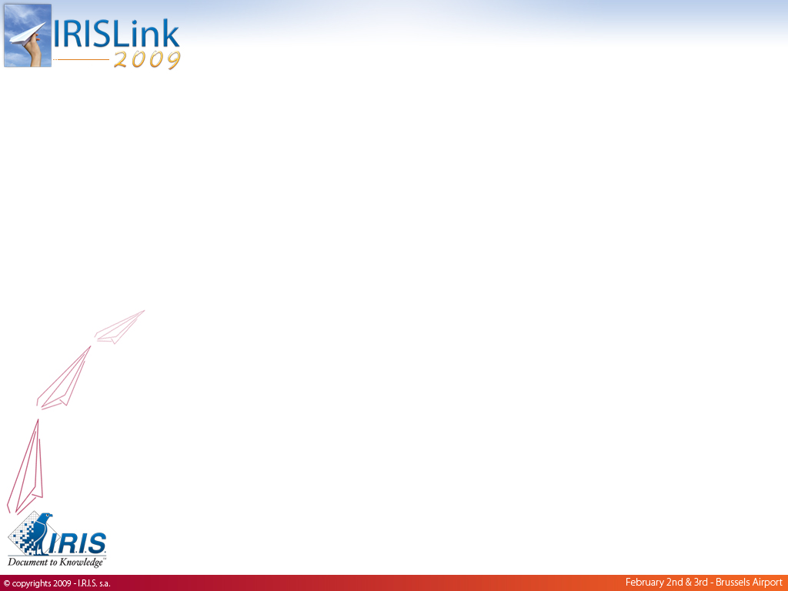
Managed Operations
MO
danny.roefflaer@irislink.com

Slide 2
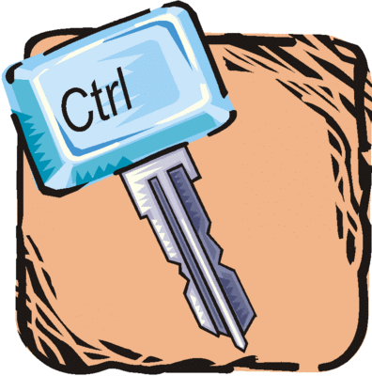
MO?
Outsourcing
  “Let a specialist manage my noncore business operations so I can focus on my business”
  concept = point of view of a customer
Managed Operations
  = managing IT business operations
  Sourcing infrastructure and services to the customer
    I.R.I.S. has the ownership
    business use: dedicated or shared
    location: Datacenter of the customer or I.R.I.S.
(Out)sourcing business of I.R.I.S.

Slide 3
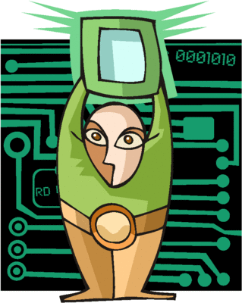
Sourcing & BCDR
Datacenter sourcing:
  Housing
  Hosting
IT sourcing
Business Process (Out)sourcing
Business Continuity & Disaster Recovery (BCDR)
Managed operations by I.R.I.S.

Slide 4
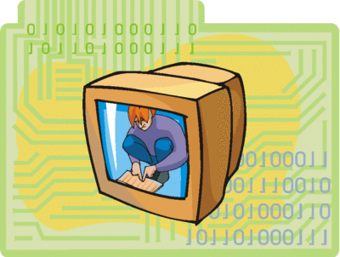
Datacenter (out)sourcing: housing
    Infrastructure:
      (Almost) no share of HW and/or network
      Mainly servers & network devices
      Power, space, network (pure co-location)
    Services:
      Monitoring HW incidents and network
      Service part from I.R.I.S. is minimal.

Slide 5
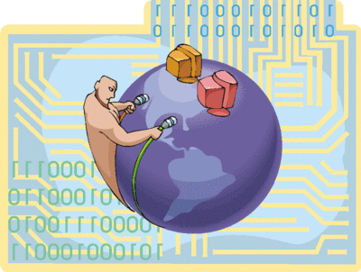
Datacenter (out)sourcing: hosting
    Infrastructure:
      Maximum share of HW, software and network
      From a (web)session to a full (virtual) datacenter
    Services:
      Systems availability, infrastructure provisioning & security, backup, ...
      Not: applications, databases, application & data access security, helpdesk, ...
      Datacenter infrastructure availability and scaling are key!
      “IT” is mainly done by the customer.

Slide 6
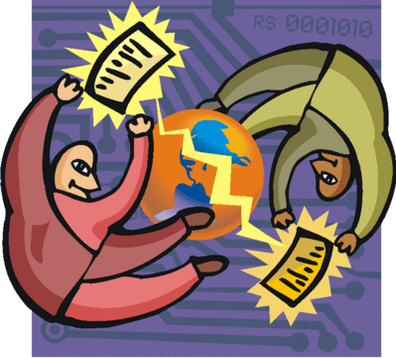
IT (out)sourcing
    Infrastructure:
      Maximum share of HW, software and network
      From a (web)session to a full (virtual) datacenter
    Services:
      Datacenter hosting but also planning, management, operations, support and innovation
      Helpdesk and multi application support are also key!
      “IT” is mainly done by I.R.I.S.

Slide 7
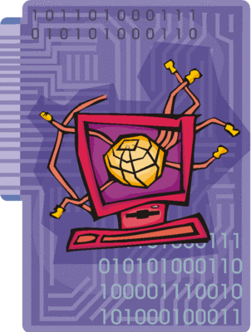
Business Process (out)sourcing
    Infrastructure:
  Max. share of HW & Software
  Typically includes finance and administration, HR, accounting, payroll, call center, customer service
  SAAS (Software-As-A-Service)
    IRIS = owner of software
    Example: IRIS DocShare, IRIS DocCenter, ...
  Services:
    Business application (out)sourcing + planning, management, operations, support and innovation
    Availability, helpdesk and specialized application support are key!
      “(partial) IT” is 100% done by I.R.I.S.

Slide 8
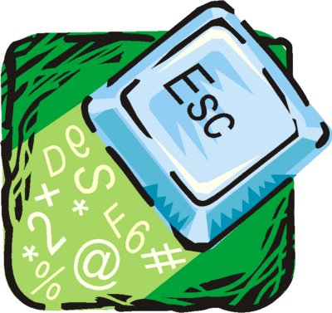
Business Continuity & Disaster Recovery (BCDR)
    Infrastructure:
  Integration with customers IT is key
  Possibility to execute: compatibility, DR tests, User access in disaster mode, performance, security, ...
  Services:
    Backup/Restore & Data replication: provisioning, monitoring, restore/failover, DR tests
    High level consultancy
      Network, Storage, Virtualization, DR plans, ...
      Innovation & Integration

Slide 9
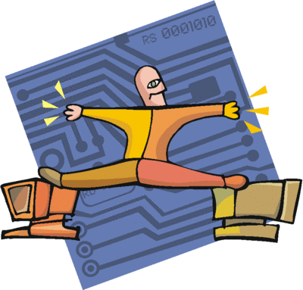
Utility and Cloud computing
Utility computing
  Relates to an IT business model
  Receiving computing resources from a service provider and “pay by the drink” (like electricity)
Cloud computing:
  Broader concept than utility computing
  Relates to the way how the service provider designes the underlying architecture (infrastructure and services)
  But relates also to the way the customer designs his internal corporate IT infrastructure to connect to “the” cloud

Slide 10
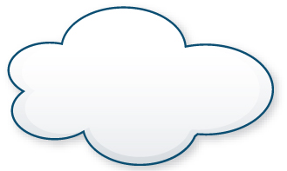
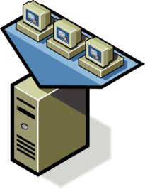
VMware vCloud: Extended DataCenter
Corporate or Public Cloud Based Service
DataCenter
Virtual
Center
API
Remote Monitoring of VM based applications
Policies Move with VM based application
V-Motion
Simplified migration of VM based application
Current
Underway

